Slide 1
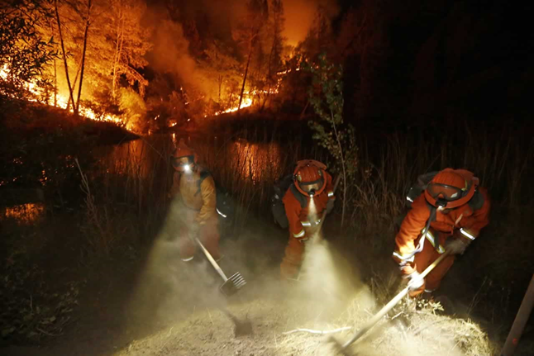
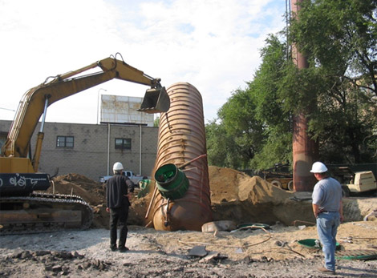
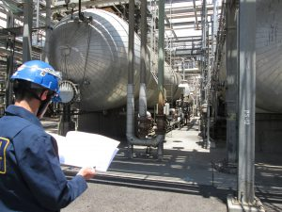
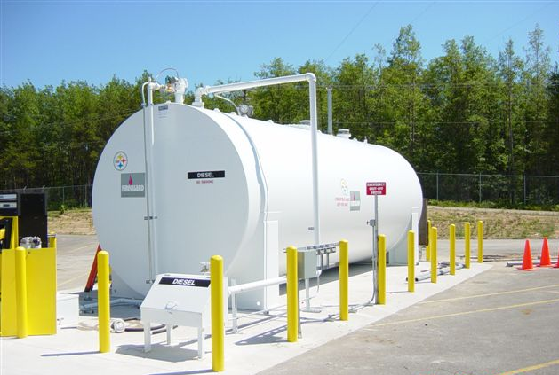
2019
CUPA CONFERENCE
SPONSORSHIP OPPORTUNITIES

Slide 2
The California CUPA Forum is a non-profit 501(c)(6) statewide association (Tax ID# 95-4720243)
81 Certified Unified Program Agencies and 24 Participating Agencies implement the Unified Program.
There are over 6,000 member accounts in the calcupa.org website.
Introduction
The organization works with the Office of the State Fire Marshal, the California Office of Emergency Services, the Department of Toxic Substances Control, the State Water Resources Control Board and Cal EPA to update and continuously improve the Unified Program for the agencies, businesses and the communities we serve.
For the past 20 years, the California CUPA Forum Board has invited both government entities and industries to attend and receive the same training at the annual training conference.
The California CUPA Forum's focus is on how we can work with all parties, both internal and external, to:
Develop guidance, regulations, and policies regarding CUPA administration.
Establish positions on statewide issues affecting CUPAs and provide a unified CUPA response to such issues.
Coordinate an information exchange between CUPAs and the State on statewide issues.
Assist in making professional training available to both CUPA agencies and industry.

Slide 3
2018 CUPA CONFERENCE | RECAP
Event Name | 20th California Unified Program Annual Training Conference
Date | February 5 – 8, 2018
Location | Hyatt, San Francisco Airport, San Mateo County
Number of Attendees | 1,945
Theme | Honoring the Past, Shaping the Future
Attendee Profile | 1,600 Conference attendees plus 345 Basics of HW and Refinery Meetings 60% Government attendees 40% Industry attendees 85% of attendees attend the entire week 6% Federal gov’t (military, FBI, NASA, US EPA, Homeland Security, etc.) 18% State gov’t (labs, DTSC, SWRCB, Cal/EPA, OES, SFM, CDPH, etc.) 76% Local gov’t (counties, cities, universities, fire, environmental/public health dept, etc.)

Slide 4
2019 CUPA CONFERENCE
Event Name | 21st California Unified Program Annual Training Conference
Date | February 25 - 28, 2019
Location | Marriott, Anaheim, Orange County
Number of Attendees | 2,000 +
Theme | One Team, One Goal
Features | 12 Tracks 144 Training Sessions Facility Tours Opening Ceremony Welcome Reception Golf Tournament CUPA Cup Competition Various Committee and TAG meetings Leadership Awards Student Research Awards and Scholarships

Slide 5
Sponsorship Opportunities | Cost
Media Wall – cost for electronic display at Registration | $10,800 full 4 day sponsor or $2,700 one day sponsor
Notebook – cost to purchase conference notebook for each attendee | $2,500 – maximum of 6 sponsors
Name Badge Sponsor – offset of expense for attendee name badge printing | $2,000 – maximum of 1 sponsor
Name Badge Lanyard Reel Sponsor – cost to purchase name badge lanyard reels made with hemp with the California CUPA Forum logo for attendees | $500 –bronze $1,000–silver $1,500 –gold
Coffee Service – offset of expense for morning break or afternoon break coffee service | $500 –bronze $1,000–silver $1,500 –gold
Sunday, 2/24 Golf Tournament Sponsor – offset to costs associated with the golf tournament | $100
Monday, 2/25 Industry Stakeholders Meeting - offset of expenses for hors d’ oeuvres | $1,000
Tuesday, 2/26 Opening Ceremony – offset of expenses for keynote speaker | $10,000
Wednesday, 2/27 2:45pm Cookie Break Sponsor – offset of expense to provide cookies at the Wednesday afternoon break in between training sessions | $500 –bronze $1,000–silver $1,500 –gold
Wednesday, 2/27 Welcome Reception – offset of expenses for hors d’ oeuvres | $5,000
Band Sponsor – cost to provide musical entertainment at the 2/26 Welcome or 2/27 Exhibitor reception | $500 – specify reception
Wednesday, 2/27 CUPA Cup Event Sponsor – offset of expenses for CUPA Cup event CUPA Cup Corn Hole or Ping Pong Table Sign – sponsor a corn hole station or ping pong table | $5,000 $250
Sponsor and Exhibitor Enhancements (2/26 & 2/27 Reception only) – purchased directly through the Marriott Drink Ticket Sponsor – offset of expense to provide drink tickets to attendees Keg at Booth – cost to provide a keg in your Exhibit space Exhibitor Wine Station – cost to provide a wine station in your Exhibit space Exhibitor Dessert Station – cost to provide a dessert station in your Exhibit space Smoothie Station – cost to provide a smoothie station in your Exhibit space | Estimated Costs $1,000 - $2,500 $1,500 $500 - $1,000 $250-$500 $1,000
Raffle Prize Donation – raffle prize tickets are given to attendees who visit all Exhibitors and raffle prize winners are drawn at Thursday’s luncheon | $50 minimum value

Slide 6
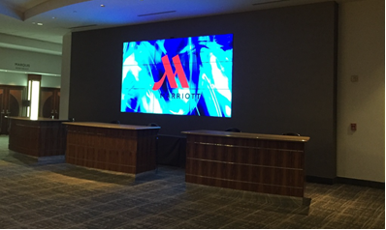
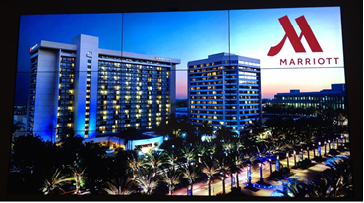
DESCRIPTION AND SPONSOR BENEFITS
Media Wall Sponsor
Sponsor receives:
"Sponsored by" slide throughout the video display on sponsored day
Recognition one-sheet in 2,000+ conference notebooks
Recognition on sponsor slide in breakfast, lunch and reception slide show
Sponsorship logo in Sponsorship Information posted at calcupa.org
Literature space for your promotional materials
Acknowledgement at the Opening Ceremony
General Specs:
- One 7’x 12’ LCD video wall comprised of 9) 55” seamless LCD displays
- Located on the main floor behind Registration
- Standard utilization includes one input source across all displays
- Total wall standard resolution @ 1920x1080 60 Hz resolution
Features:
Logo Branding - Brand Recognition with Company Logos for Sponsors and
Exhibitors
Agenda Display - Attendees will be kept up to date with changes in real time
to the Schedule of Events and Meeting Locations.
Featured Events - Opening Ceremony with featured Keynote Speaker, announcement
of Unified Program Leadership Awards, Student Research and CUPA Cup winners

Slide 7
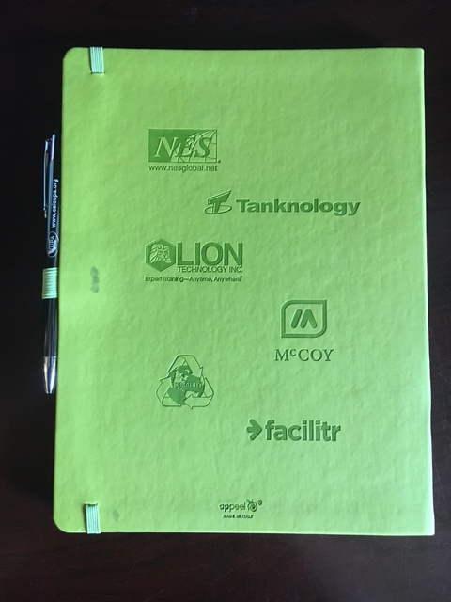
Notebook Sponsor
Sponsor receives:
Recognition on Media Wall display
Debossed logo on the back of 2,000+ conference notebooks
Recognition on sponsor slide in breakfast, lunch and reception slide show
Sponsorship logo in Sponsorship Information posted at calcupa.org
Literature space for your promotional materials
General Specs:
- Artwork must be received as a one color EPS file
- Maximum number of sponsors = 6
- Deadline to participate as a sponsor is November 30, 2018

Slide 8
Name Badge Sponsor
Sponsor receives:
Logo on 2,000+ double-sided name badges
Recognition on sponsor slide in breakfast, lunch and reception slide show
Sponsorship logo in Sponsorship Information posted at calcupa.org
Literature space for your promotional materials
General Specs:
Maximum number of sponsors = 1
- Deadline to participate as a sponsor is December 31, 2018
Name Badge Lanyard Reel Sponsor
Sponsor receives:
Recognition on sponsor slide in breakfast, lunch and reception slide show
Sponsorship logo in Sponsorship Information posted at calcupa.org
Literature space for your promotional materials
General Specs:
- Deadline to participate as a sponsor is December 31, 2018
Sample of last year’s badge

Slide 9
Coffee Service Sponsor
Sponsor receives:
Recognition on Media Wall display (sponsorship day only)
Recognition at coffee station
Recognition on sponsor slide in breakfast, lunch and reception slide show
Sponsorship logo in Sponsorship Information posted at calcupa.org
Literature space for your promotional materials
Golf Tournament Sponsor
Sponsor receives:
Recognition on sponsor slide in breakfast, lunch and reception slide show
Sponsorship logo in Sponsorship Information posted at calcupa.org
Literature space for your promotional materials
WISH LIST
Golf Towels
Golf Caps
Golf Balls
Ball Markers
Divot Tools
Golf Umbrellas
Golf Coolers

Slide 10
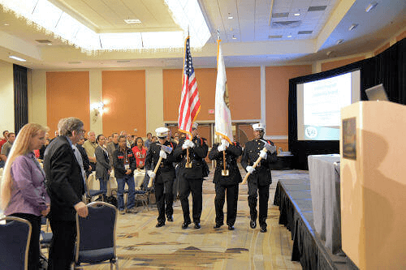
Industry Stakeholders Meeting
Sponsor receives:
Recognition slide in meeting room
Recognition on sponsor slide in breakfast, lunch and reception slide show
Brochure table space in meeting room
Sponsor sign at hors ‘d oeuvres table
Opening Ceremony Sponsor
Sponsor receives:
Recognition on Media Wall display (Monday & Tuesday)
Recognition one-sheet in 2,000+ conference notebooks
Recognition on sponsor slide in breakfast, lunch and reception slide show
Acknowledgement at Opening Ceremony
Sponsorship logo in Sponsorship Information posted at calcupa.org
Literature space for your promotional materials
Wednesday Cookie Break Sponsor
Sponsor receives:
Recognition on Media Wall display (Monday, Tuesday & Wednesday)
Recognition at Wednesday afternoon cookie station
Recognition on sponsor slide in breakfast, lunch and reception slide show
Sponsorship logo in Sponsorship Information posted at calcupa.org

Slide 11
Welcome Reception Sponsor
Sponsor receives:
Recognition on Media Wall display (Monday & Tuesday)
Recognition one-sheet in 2,000+ conference notebooks
Recognition on sponsor slide in breakfast, lunch and reception slide show
Acknowledgement at Welcome Reception
Sponsorship logo in Sponsorship Information posted at calcupa.org
Literature space for your promotional materials
Band Sponsor
Sponsor receives:
Recognition on Media Wall display (Monday, Tuesday & Wednesday)
Acknowledgement at Reception
(Welcome Reception – Tuesday, 2/26, from 4:45pm – 6:00pm)
(Vendor Reception – Wednesday, 2/27, from 4:45pm to 6:00pm)
Recognition on sponsor slide in breakfast, lunch and reception slide show
Sponsorship logo in Sponsorship Information at calcupa.org

Slide 12
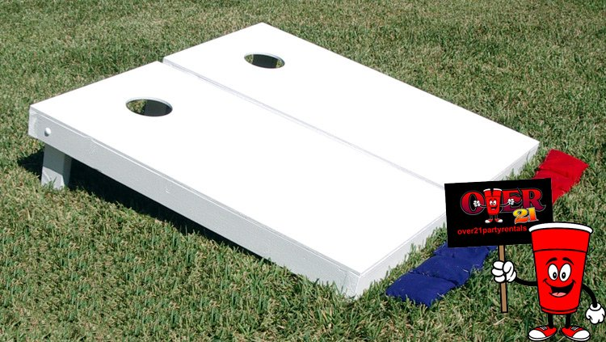
CUPA Cup Event Sponsors
Sponsors receive:
Recognition on Media Wall display (Tuesday & Wednesday)
Recognition on CUPA Cup one-sheet in 2,000+ conference notebooks
Recognition on sponsor slide in breakfast, lunch and reception slide show
Sponsorship logo in Sponsorship Information posted at calcupa.org
Literature space for your promotional materials
CUPA CUP Corn Hole (competitive event)
Casino / Ping Pong (non-competitive events)
Sponsored by (your name here)

Slide 13
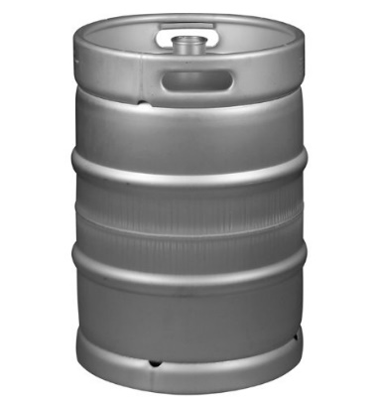
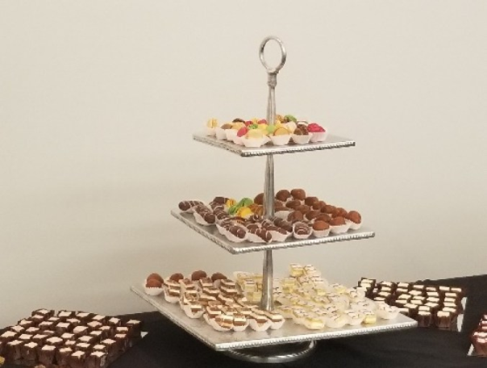
Sponsor and Exhibitor Enhancements – to be purchased directly through the Marriott
Keg Wine Station
Drink Ticket Sponsor
Dessert Station Smoothie Station

Slide 14
Raffle Prize Donation
Sponsor receives:
Recognition on Raffle Prize slide on Media Wall display
Recognition on Exhibitor and Raffle Prize one-sheet in 2,000+ conference notebooks
Recognition on sponsor slide in breakfast, lunch and reception slide show
Recognition at Registration Desk
Sponsorship logo in Sponsorship Information posted at calcupa.org
Recognition during raffle prize drawings at Thursday’s luncheon

Slide 15
For answers to questions on sponsorship opportunities
or to submit a proposal
please contact:
Patti Rosol-Cary
ceuadmin@calcupa.org
714-765-4081
714-262-1721
Sheryl Baldwin
sheryl@calcupa.org
530-676-0815
Thank you, in advance, for your consideration!

